Slide 1
Comparison of Financial Metrics for LTIP Performance Payouts
Metric | Definition | CEO Control & Strategic Fit | Pros | Cons
EBITDA | Earnings before interest, taxes, depreciation, and amortization. | ✅ High control – reflects operational efficiency and profit strategy. | Core profit metric; aligns with operational performance; not skewed by taxes or financing. | Can be inflated short-term by cutting key spend; ignores capex needs.
Enterprise Value (EV) Growth | Increase in company value based on discounted cash flow (DCF) of future free cash flows and terminal value. | ✅ Strategic fit – aligns with long-term value creation and investor returns. | Ultimate value creation metric; aligns with company valuation for potential exit/IPO. | Requires modeling; doesn't translate to short-term ops performance.
Free Cash Flow (FCF) | Operating cash flow minus capital expenditures; measures real cash generated from operations. | ✅ Medium control – influenced by operating decisions and capital investments. | Real measure of liquidity and long-term sustainability. | Volatile due to capex timing; influenced by working capital shifts.
Revenue Growth | Total top-line sales growth, before costs or expenses. | ✅ High control – directly linked to CEO’s growth strategy and go-to-market execution. | Easy to understand and measure; encourages growth focus. | Can incentivize growth at all costs without profit discipline.
Net Income | Profit after all costs, taxes, and interest — the bottom line of the income statement. | ❌ Low control – impacted by tax rates, interest, and accounting rules. | Standard GAAP metric; reflects final profitability. | Not reflective of actual operating performance in private firms.
EBIT | Earnings before interest and taxes; includes depreciation and amortization. | ⚠️ Partial control – includes non-cash elements not directly tied to daily ops. | Includes impact of asset investment through depreciation. | Can be distorted by accounting rules; less clear than EBITDA.
NOTE:
It’s considered best practice to use Enterprise Value (EV) Growth or EBITDA as LTIP performance metrics instead of Net Income. These metrics better reflect the CEO’s operational impact and long-term value creation, without being skewed by taxes, interest, or accounting treatments outside of their control.
This table outlines the definitions, pros, and cons of each financial metric from a private company CEO LTIP design perspective, helping clarify alignment with private companies' strategic goals.

Slide 2
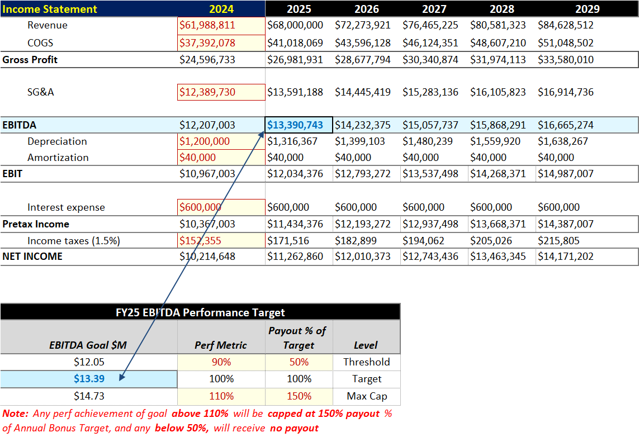
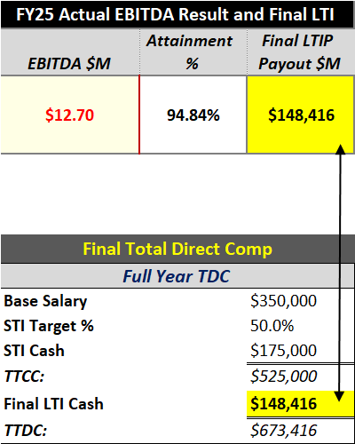
LTIP Calculation Based on EBITDA Performance
Income Statement Forecast: Historical financial data (2022-2024) was used to project the company's Income Statement for 2025-2029, establishing a clear baseline for setting performance targets.
Performance Metric – EBITDA: The model sets an FY25 EBITDA target of $13.39M, which serves as the performance measure for the Long-Term Incentive Plan (LTIP).
Payout Matrix: The payout is determined using a performance-payout matrix:
90% of target EBITDA ($12.05M) triggers a 50% payout of the LTIP target.
100% of target EBITDA ($13.39M) provides a 100% payout.
110% of target EBITDA ($14.73M) caps the payout at 150%.
Interpolated Calculation: Actual EBITDA for FY25 is $12.70M (94.85% of target). This is between 90% and 100%, resulting in a 74.23% payout of the $200,000 LTIP target.
Final Result: The final LTIP payout for FY25 is $148,469, reflected in the Total Direct Compensation (TDC) calculation.

Slide 3
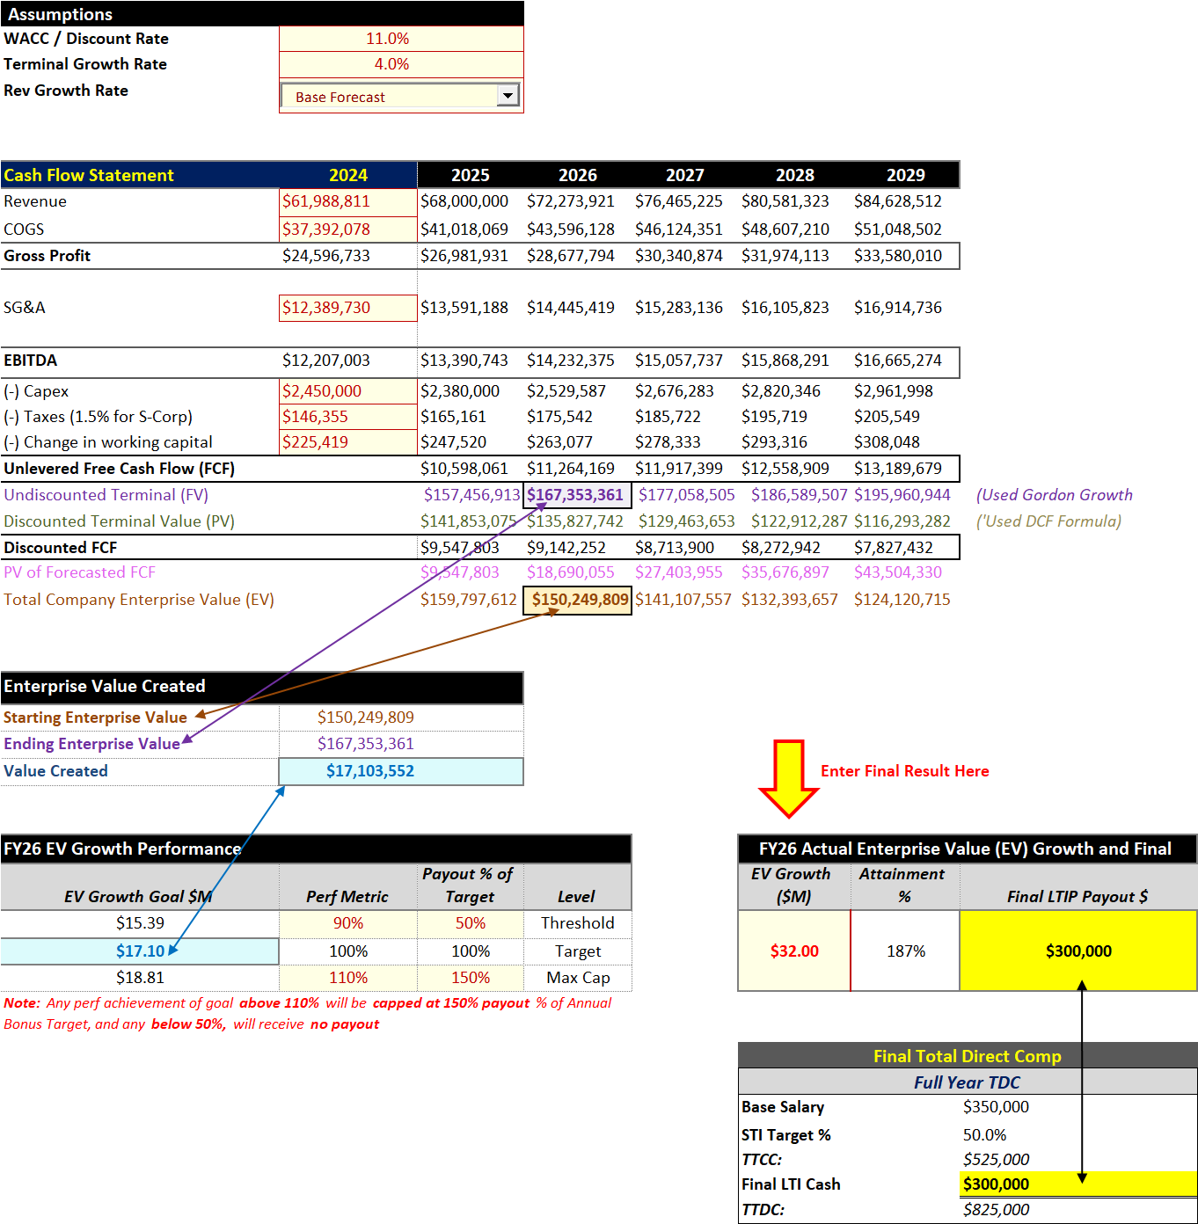
LTIP Calculation Based on Enterprise Value (EV) Growth
Enterprise Value (EV) Forecasting: The model uses a Discounted Cash Flow (DCF) approach to project annual Enterprise Value (EV) from 2025 to 2029, leveraging key assumptions including a WACC of 11% and a Terminal Growth Rate of 4%.
Value Creation as a Performance Metric: The model calculates the difference between the Starting Enterprise Value ($150.25M) and the Ending Enterprise Value ($167.35M) for FY26, resulting in Value Created of $17.10M.
Performance-Payout Matrix: Payouts are determined using a performance-to-payout matrix:
Threshold (90%) of EV Growth ($15.39M) triggers a 50% payout of the LTIP target.
Target (100%) of EV Growth ($17.10M) provides a 100% payout.
Maximum (110%) of EV Growth ($18.81M) caps the payout at 150%.
Any performance below 90% earns no payout.
Actual Result and Payout Calculation: Actual EV Growth for FY26 is $32.00M, which represents 187% attainment of the target. Since this exceeds the 110% cap, the payout is capped at 150% of the LTIP target.
Final Result: With an LTIP target of $200,000, the final LTIP payout is $300,000, which is reflected in the Total Direct Compensation (TDC) calculation of $825,000.

